Slide 1
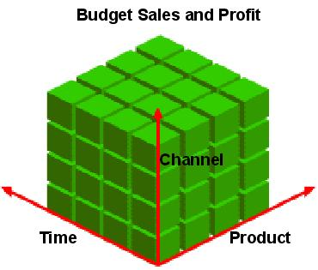
OLAP - Dimensional modeling
www.cl.cam.ac.uk/Teaching/current/Databases/
Notes:
분석단 -> denormalization 시킨다. 데이터 분석을 위해서 사용되므로 데이터 변경이 일어나지 않는다. 따라서 ,integrity constraint 고려하지 않아도 되기 때문에, join을 시키지 않기 위해서 denormalization 시킨다.

Slide 2
Conceptual Modeling of Data Warehouses
Modeling data warehouses: dimensions & measures
  Star schema: A fact table in the middle connected to a set of dimension tables
  Snowflake schema: A refinement of star schema where some dimensional hierarchy is normalized into a set of smaller dimension tables, forming a shape similar to snowflake
  Fact constellations: Multiple fact tables share dimension tables, viewed as a collection of stars, therefore called galaxy schema or fact constellation

Slide 3
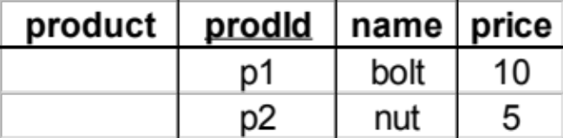
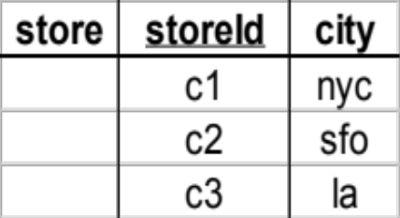
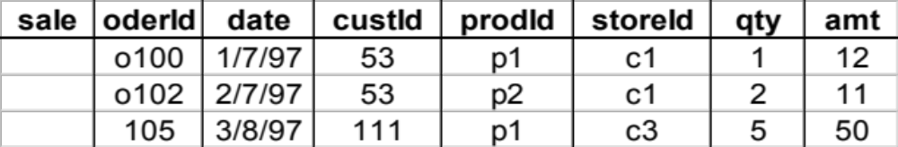
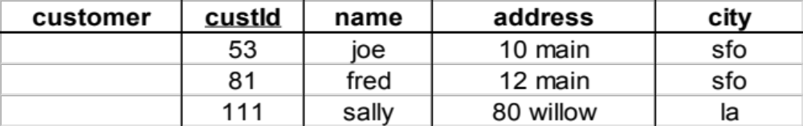
Star
Notes:
장점 : 분석을 할때 join을 여러 번 하지 않아도 된다. 관심있는 데이터를 간단히 접근할 수 있다.

Slide 4
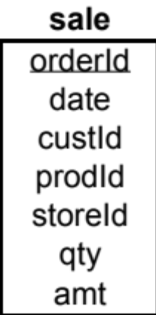
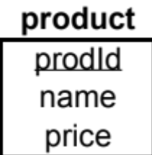
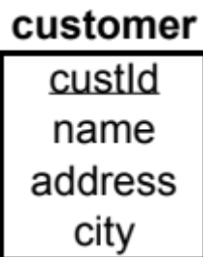
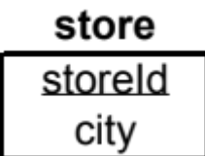
Star Schema

Slide 5
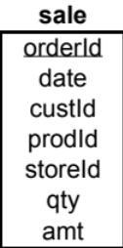
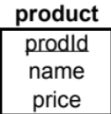


Terms
Fact table (sale)
Dimension tables (product,customer,store)
Measures
(qty,amt 같이 관심 있는 데이터를 fact table에 따로 저장)
Notes:
데이터 웨어하우스
데이터 마트

Slide 6
Another Star Schema
time
time_key
day
day_of_the_week
month
quarter
year
item
item_key
item_name
brand
type
supplier_type
Sales Fact Table
time_key
item_key
branch_key
branch
location
location_key
branch_key
branch_name
branch_type
location_key
street
city
province_or_street
country
units_sold
dollars_sold
avg_sales
Measures

Slide 7
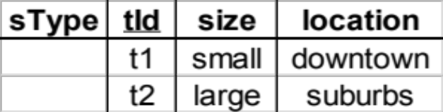
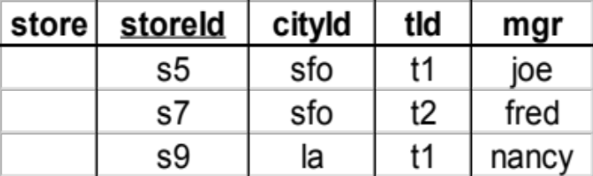
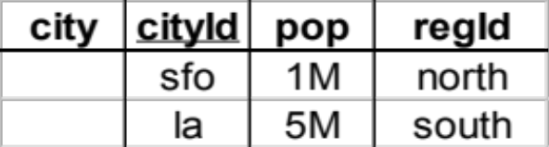
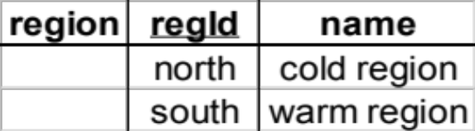
Dimension Hierarchies
sType
store
city
region
➔ snowflake schema
➔ constellations

Slide 8
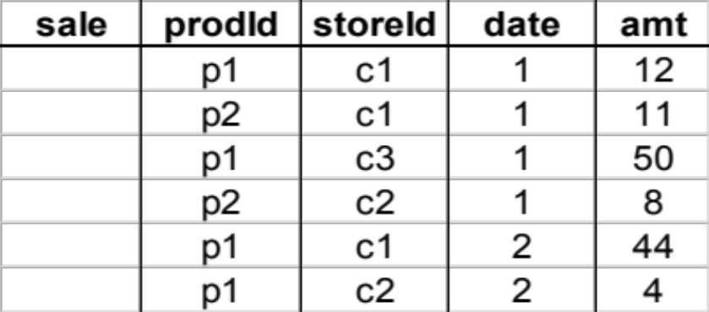
Aggregates
Add up amounts for day 1
In SQL: SELECT sum(amt) FROM SALE
WHERE date = 1
81

Slide 9
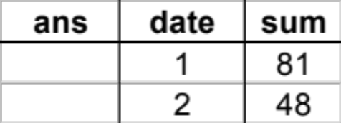
Aggregates
Add up amounts by day
In SQL: SELECT date, sum(amt) FROM SALE
GROUP BY date

Slide 10
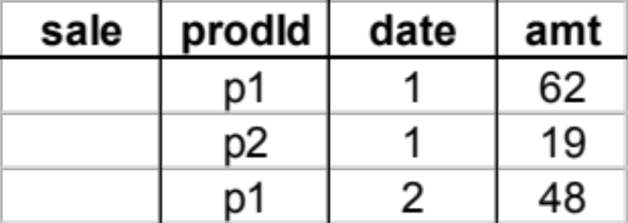
Another Example
Add up amounts by day, product
In SQL: SELECT date, sum(amt) FROM SALE
GROUP BY date, prodId
rollup
drill-down
Notes:
Drill-across dimension1 – fact1 - fact2 – dimension2
Fact1에서 dimension2접근

Slide 11
Aggregates
Operators: sum, count, max, min, median, ave
“Having” clause
Using dimension hierarchy
  average by region (within store)
  maximum by month (within date)

Slide 12
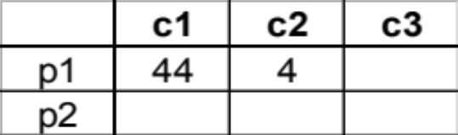
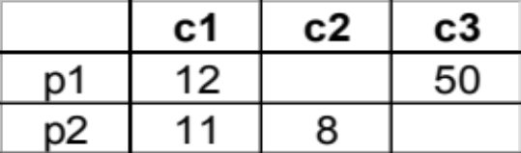
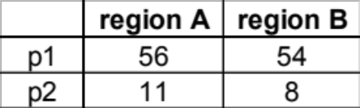
Aggregation Using Hierarchies
day 2
customer
day 1
region
country
(customer c1 in Region A;
customers c2, c3 in Region B)

Slide 13

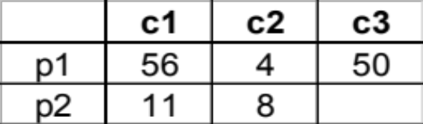
Pivoting
Fact table view:
Multi-dimensional cube:
day 2
day 1

